Slide 1
Heaps
Materials are adapted from “Data Structures: A Pseudocode Approach with C,” 2nd ed., by Richard F. Gilberg & Behrouz A. Forouzan

Slide 2
Basic Concepts
A Heap
is a binary tree structure with the following properties:
The tree is complete or nearly complete
The key value of each node is greater than or equal to the key value in each of its descendents (max-heap)
→ Min-heap : the key value in a node is less than the key values in all of its subtrees
The root of a heap is guaranteed to hold the largest node in the tree
Both the left and the right branches of the tree have the same properties
Heaps are often implemented in an array rather than a linked list.
When arrays are used, we are able to calculate the location of the left and the right subtrees. Conversely, we can calculate the address of it’s parent

Slide 3
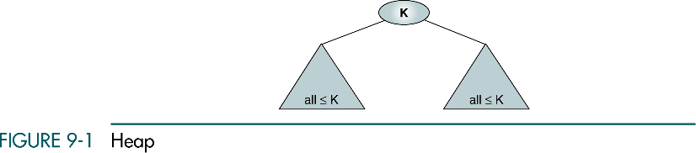
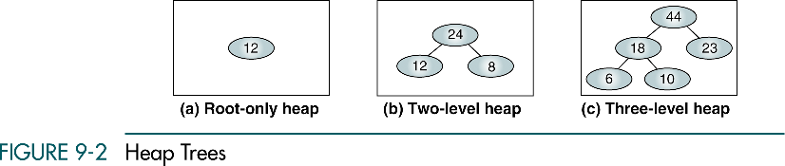

Slide 4
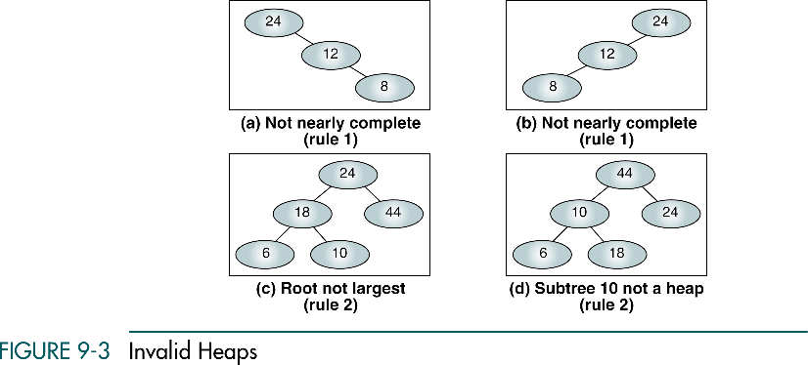

Slide 5
Maintenance Operations
Two basic maintenance operations are performed on a heap:
Insert a node
Delete a node
Although the heap structure is a tree, it is meaningless to traverse it, search it, or print it out
To implement the insert and delete operations,
Two basic algorithms : Reheap up and Reheap down

Slide 6
Reheap Up
The reheap up operation repairs the structure so that it is a heap by floating the last element up the tree until that element is in its correct location
Insertion takes place at a leaf at the first empty position. (the heap is a complete or nearly complete tree)
This may create a situation where the new node’s key is larger than that of its parent
If it is, the node is floated up the tree by exchanging the child and parent keys and data

Slide 7
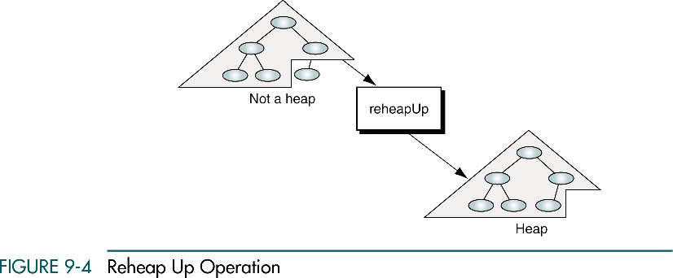
Reheap Up

Slide 8
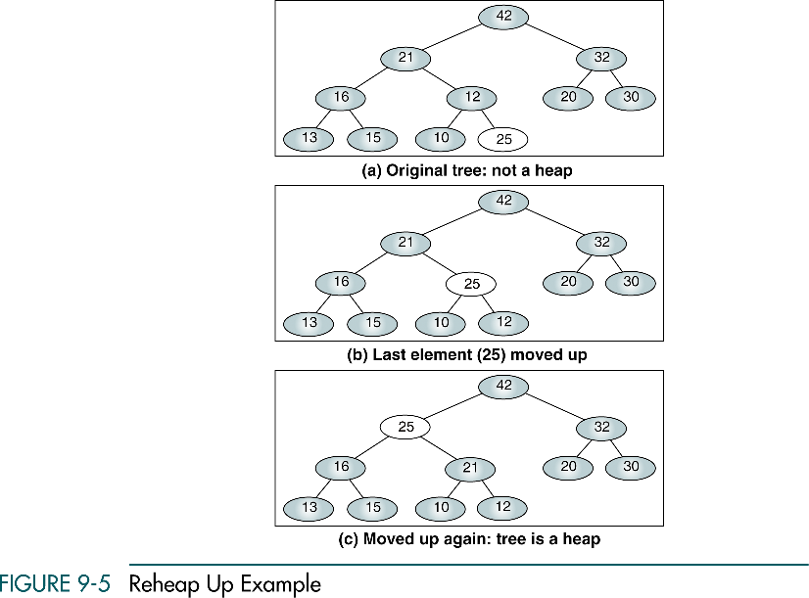

Slide 9
Reheap Down
When we have a nearly complete binary tree that satisfies heap order property except in the root position
This situation occurs when the root is deleted from the tree, leaving two disjointed heaps
To correct this situation, we move the data in the last tree node to the root
The reheap down operation reorders a broken heap by pushing the root down the tree until it is in a position where the heap-ordering property is satisfied

Slide 10
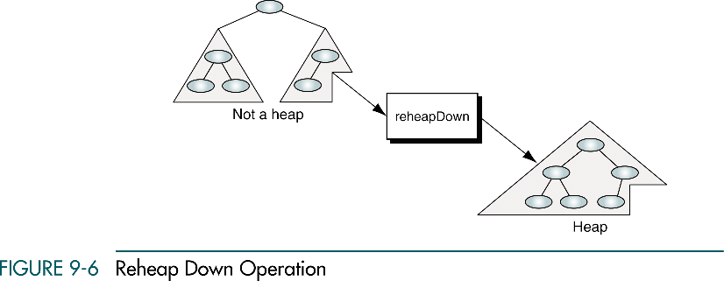
Reheap Down

Slide 11
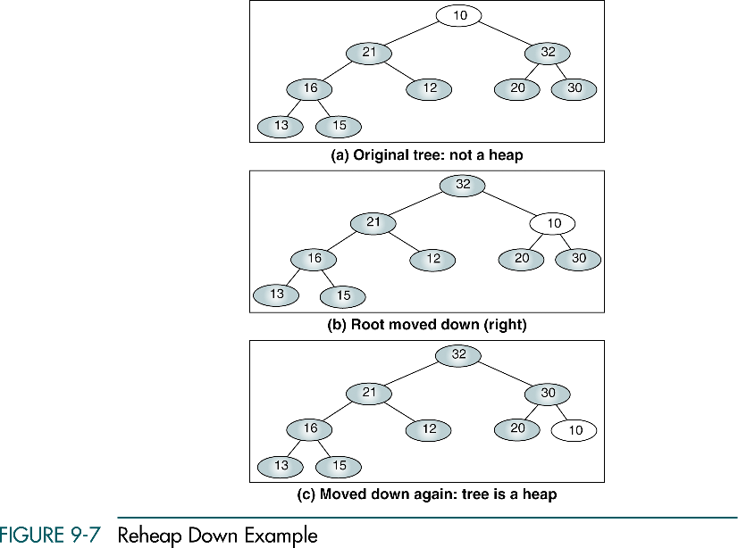

Slide 12
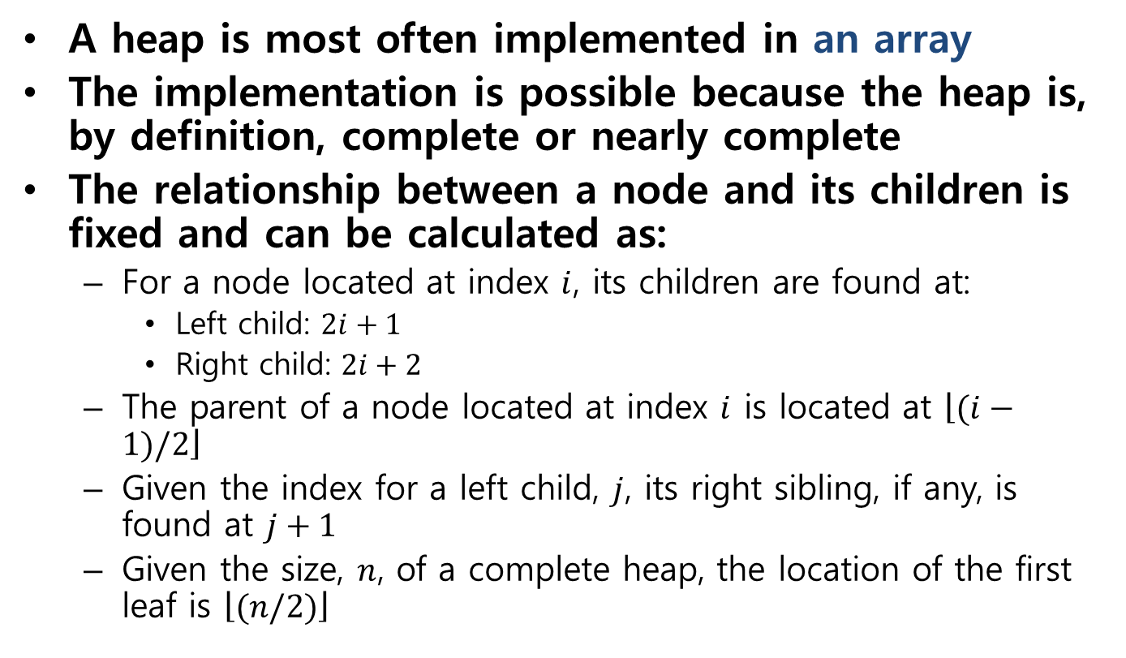
Heap Implementation
A heap is most often implemented in an array
The implementation is possible because the heap is, by definition, complete or nearly complete
The relationship between a node and its children is fixed and can be calculated as:
For a node located at index $i$, its children are found at:
Left child: $2i+1$
Right child: $2i+2$
The parent of a node located at index $i$ is located at $\left\lfloor (i−1)/2\right\rfloor$
Given the index for a left child, $j$, its right sibling, if any, is found at $j+1$
Given the size, $n$, of a complete heap, the location of the first leaf is $\left\lfloor (n/2)\right\rfloor$

Slide 13
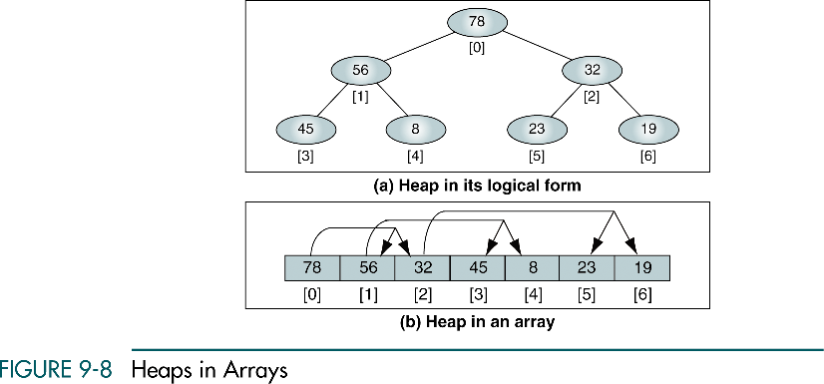
Base-zero index addressing

Slide 14
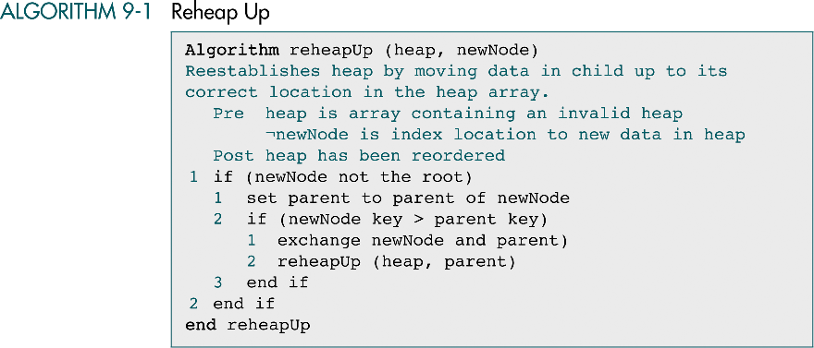

Slide 15
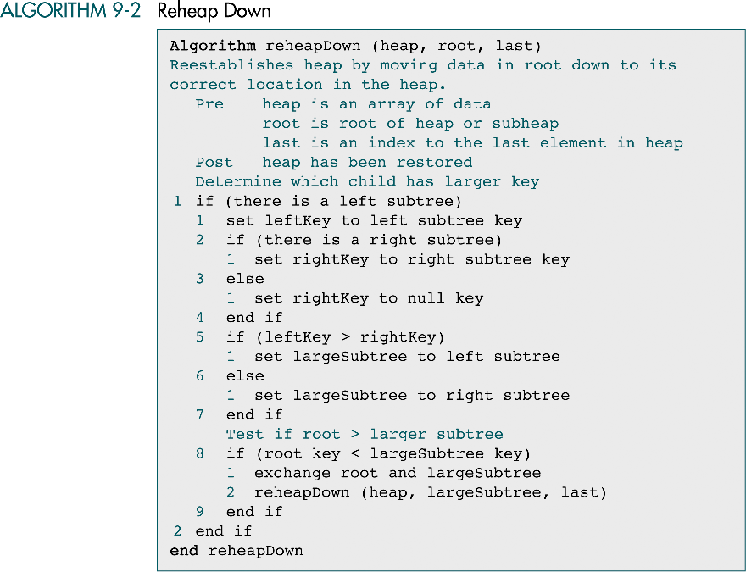

Slide 16
(continued)

Slide 17
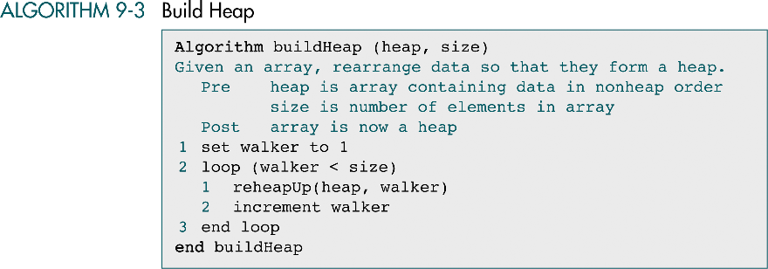

Slide 18
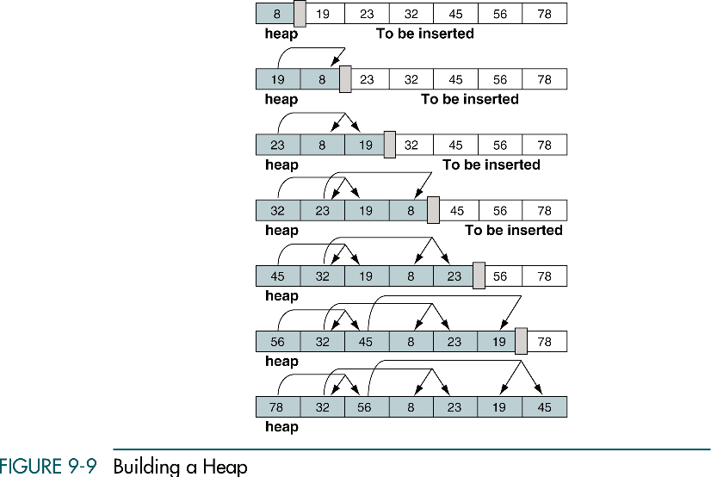
→ heapify

Slide 19
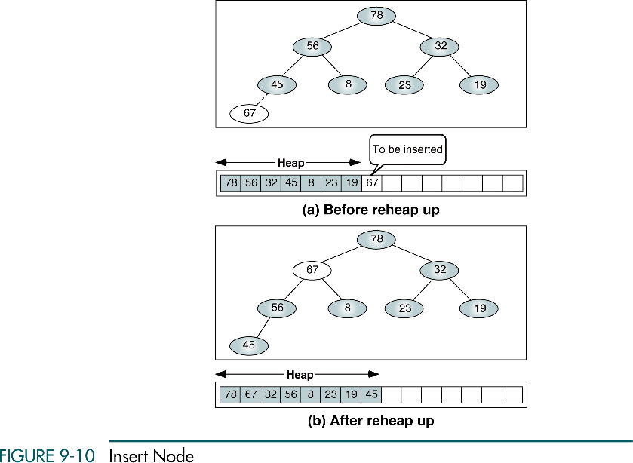

Slide 20
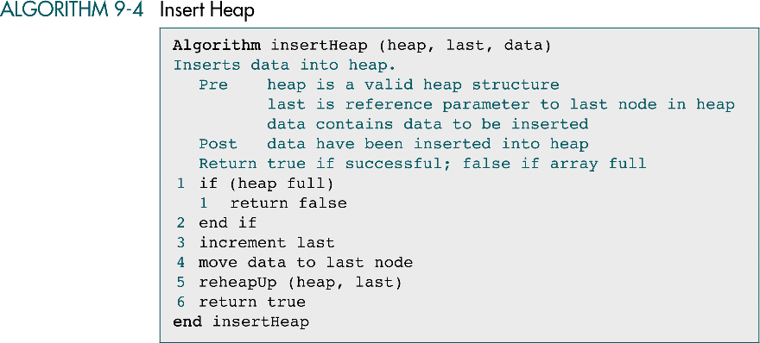

Slide 21
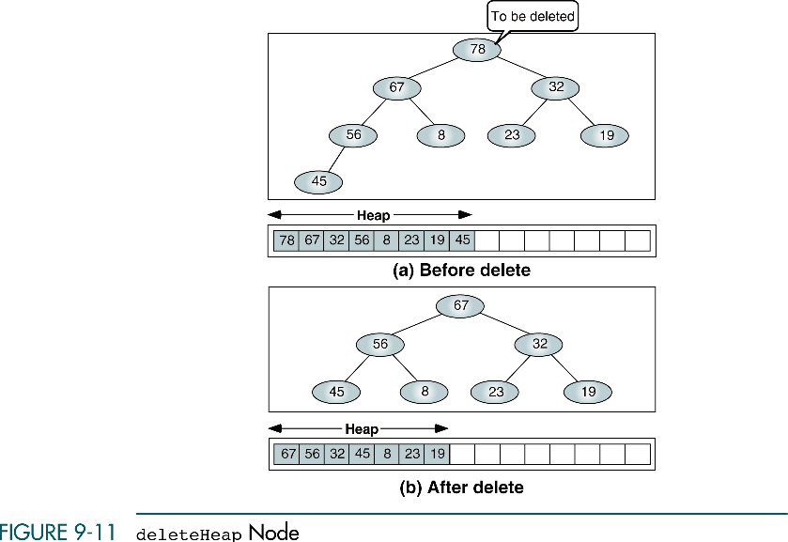
``

Slide 22
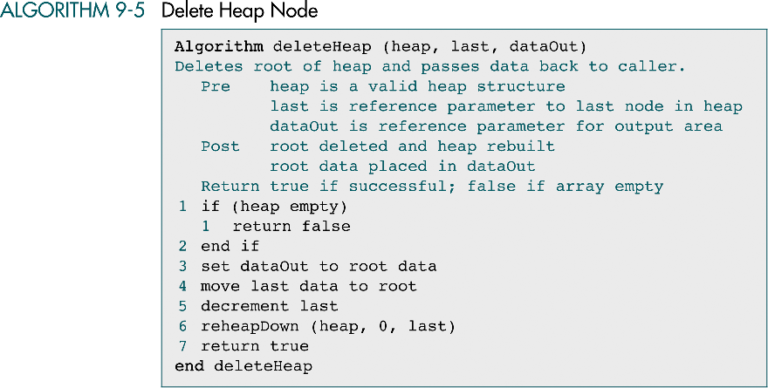
``

Slide 23
Heap Applications
Three common heap applications of heaps
Selection algorithms
Priority queues
Sorting

Slide 24
Selection algorithms
The problem of determining the kth element in an unsorted list
Sort the list and select the element at location k
Create a heap and delete k - 1 elements from it, leaving the desired element at the root

Slide 25
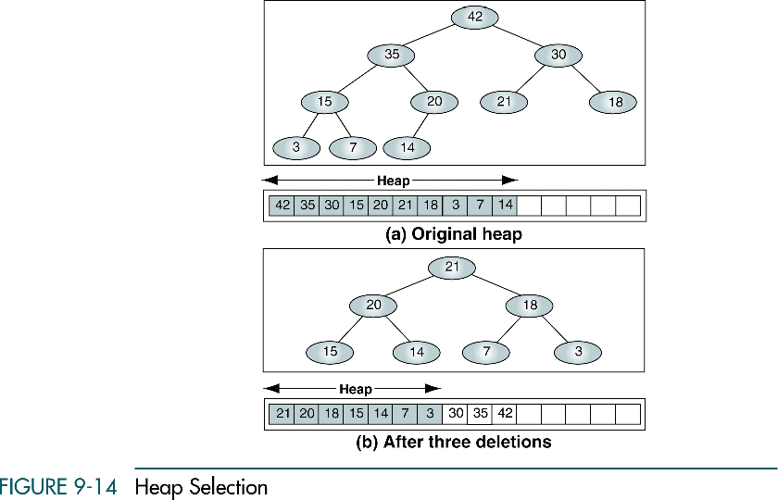
We want to know the 4th largest element
in a list

Slide 26
